Slide 1
Distance Measures
Tan et al.
From Chapter 2

Slide 2
Similarity and Dissimilarity
Similarity
  Numerical measure of how alike two data objects are.
  Is higher when objects are more alike.
  Often falls in the range [0,1]
Dissimilarity
  Numerical measure of how different are two data objects
  Lower when objects are more alike
  Minimum dissimilarity is often 0
  Upper limit varies
Proximity refers to a similarity or dissimilarity

Slide 3
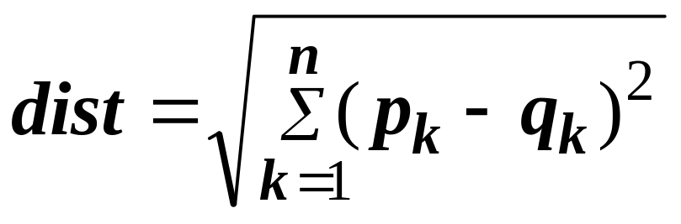
Euclidean Distance
Euclidean Distance
  Where n is the number of dimensions (attributes) and p_{k} and q_{k} are, respectively, the k^{th} attributes (components) or data objects p and q.
Standardization is necessary, if scales differ.

Slide 4
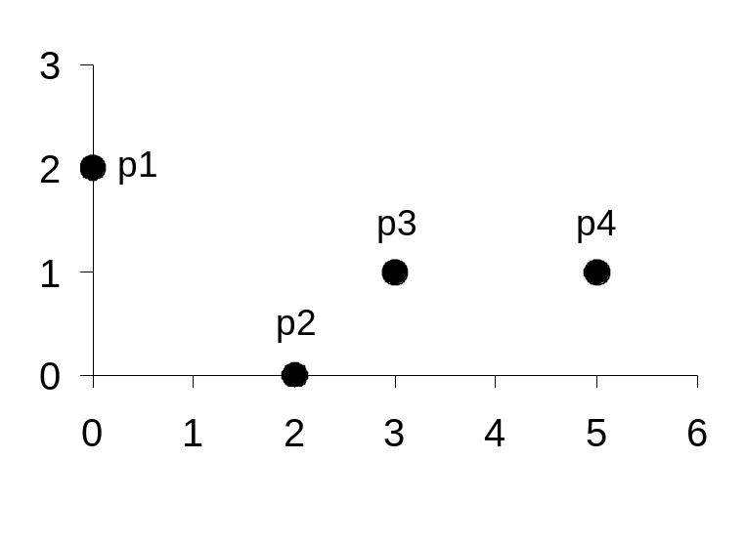
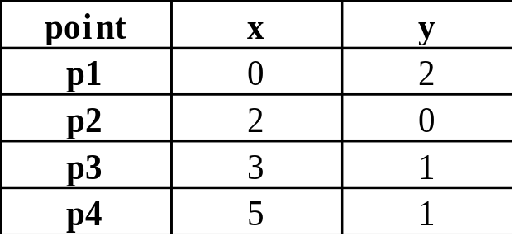
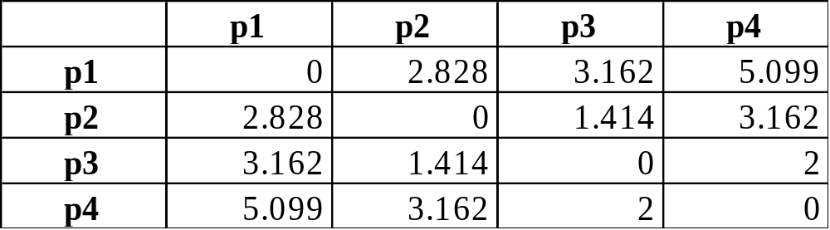
Euclidean Distance
Distance Matrix

Slide 5
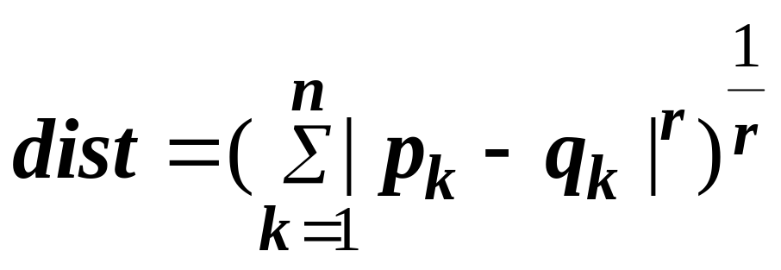
Minkowski Distance
Minkowski Distance is a generalization of Euclidean Distance
  Where r is a parameter, n is the number of dimensions (attributes) and p_{k} and q_{k} are, respectively, the kth attributes (components) or data objects p and q.

Slide 6
Minkowski Distance: Examples
r = 1. City block (Manhattan, taxicab, L₁ norm) distance.
  A common example of this is the Hamming distance, which is just the number of bits that are different between two binary vectors
r = 2. Euclidean distance
r → ∞. “supremum” (L_{max} norm, L∞ norm) distance.
  This is the maximum difference between any component of the vectors
  Example: L_infinity of (1, 0, 2) and (6, 0, 3) = ??
  Do not confuse r with n, i.e., all these distances are defined for all numbers of dimensions.

Slide 7
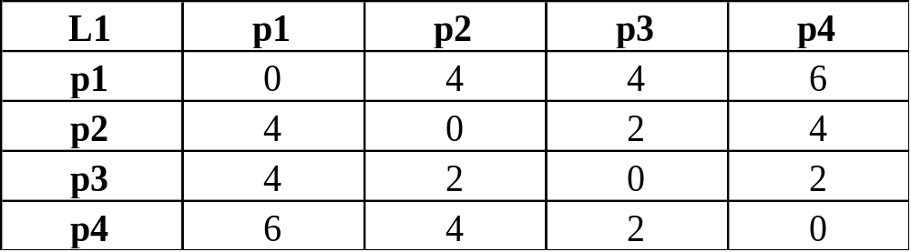
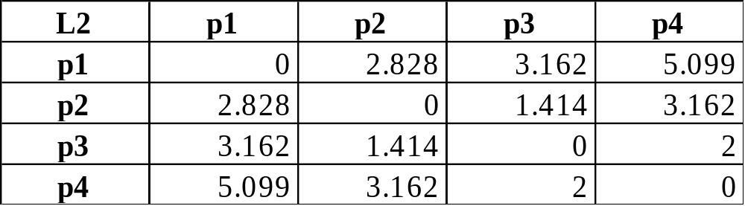
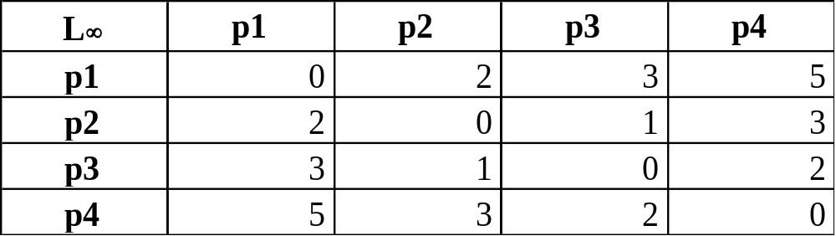
Minkowski Distance
Distance Matrix

Slide 8
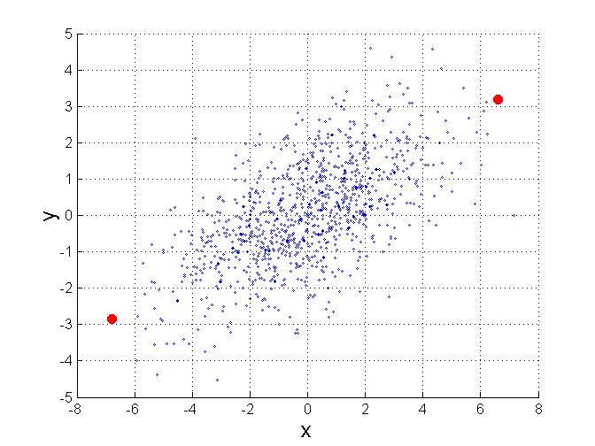
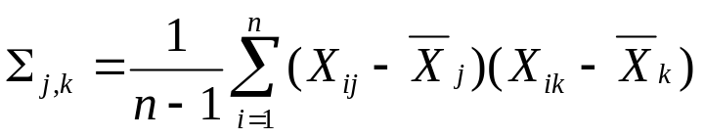
Mahalanobis Distance
Σ is the covariance matrix of the input data X
B
When the covariance matrix is identity
Matrix, the mahalanobis distance is the
same as the Euclidean distance.
Useful for detecting outliers.
Q: what is the shape of data when
covariance matrix is identity?
Q: A is closer to P or B?
A
P
For red points, the Euclidean distance is 14.7, Mahalanobis distance is 6.

Slide 9
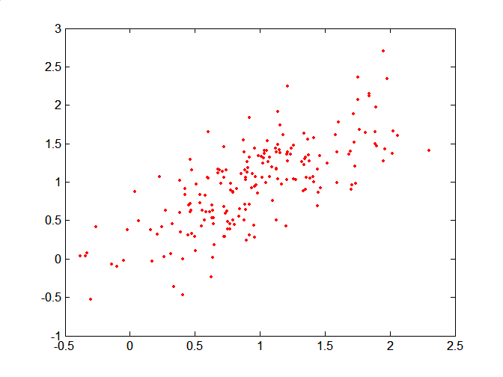
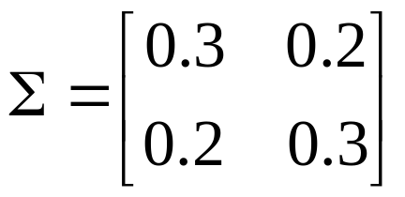
Mahalanobis Distance
Covariance Matrix:
C
B
A: (0.5, 0.5)
B: (0, 1)
C: (1.5, 1.5)
Mahal(A,B) = 5
Mahal(A,C) = 4
A

Slide 10
Common Properties of a Distance
Distances, such as the Euclidean distance, have some well known properties.
  d(p, q) ≥ 0 for all p and q and d(p, q) = 0 only if
  p = q. (Positive definiteness)
  d(p, q) = d(q, p) for all p and q. (Symmetry)
  d(p, r) ≤ d(p, q) + d(q, r) for all points p, q, and r.
  (Triangle Inequality)
where d(p, q) is the distance (dissimilarity) between points (data objects), p and q.
A distance that satisfies these properties is a metric, and a space is called a metric space

Slide 11
Common Properties of a Similarity
Similarities, also have some well known properties.
  s(p, q) = 1 (or maximum similarity) only if p = q.
  s(p, q) = s(q, p) for all p and q. (Symmetry)
where s(p, q) is the similarity between points (data objects), p and q.

Slide 12
Similarity Between Binary Vectors
Common situation is that objects, p and q, have only binary attributes
Compute similarities using the following quantities
M₀₁ = the number of attributes where p was 0 and q was 1
M₁₀ = the number of attributes where p was 1 and q was 0
M₀₀ = the number of attributes where p was 0 and q was 0
M₁₁ = the number of attributes where p was 1 and q was 1
Simple Matching and Jaccard Distance/Coefficients
SMC = number of matches / number of attributes
= (M₁₁ + M₀₀) / (M₀₁ + M₁₀ + M₁₁ + M₀₀)
J = number of value-1-to-value-1 matches / number of not-both-zero attributes values
= (M₁₁) / (M₀₁ + M₁₀ + M₁₁)

Slide 13
SMC versus Jaccard: Example
p = 1 0 0 0 0 0 0 0 0 0
q = 0 0 0 0 0 0 1 0 0 1
M₀₁ = 2 (the number of attributes where p was 0 and q was 1)
M₁₀ = 1 (the number of attributes where p was 1 and q was 0)
M₀₀ = 7 (the number of attributes where p was 0 and q was 0)
M₁₁ = 0 (the number of attributes where p was 1 and q was 1)
SMC = (M₁₁ + M₀₀)/(M₀₁ + M₁₀ + M₁₁ + M₀₀) = (0+7) / (2+1+0+7) = 0.7
J = (M₁₁) / (M₀₁ + M₁₀ + M₁₁) = 0 / (2 + 1 + 0) = 0

Slide 14
Cosine Similarity
If d₁ and d₂ are two document vectors, then
cos( d₁, d₂ ) = (d₁ • d₂) / ||d₁|| ||d₂|| ,
where • indicates vector dot product and || d || is the length of vector d.
Example:
d₁ = 3 2 0 5 0 0 0 2 0 0
d₂ = 1 0 0 0 0 0 0 1 0 2
d₁ • d₂= 3*1 + 2*0 + 0*0 + 5*0 + 0*0 + 0*0 + 0*0 + 2*1 + 0*0 + 0*2 = 5
||d₁|| = (3*3+2*2+0*0+5*5+0*0+0*0+0*0+2*2+0*0+0*0)^{0.5} = (42) ^{0.5} = 6.481
||d₂|| = (1*1+0*0+0*0+0*0+0*0+0*0+0*0+1*1+0*0+2*2) ^{0.5} = (6) ^{0.5} = 2.245
cos( d₁, d₂ ) = .3150, distance=1-cos(d1,d2)

